Slide 1


BA 810 Team 3
HR Analytics:
Predicting Career Shifts for Data Science Candidates
Xinping Yu, Ruchika Venkateswaran, Yigit Demiralp, Bosoo Kim, Muyan Xie
Notes:
Hello and welcome to our presentation----predicting career shifts for data science candidates.

Slide 2





About Us
Xinping Yu Muyan Xie Bosoo Kim Ruchika Venkateswaran Yigit Demiralp
Notes:
First, let us introduce ourselves. This is…

Slide 3

Agenda
About the Dataset
Motivation and Business Problem
Data cleaning summary
EDA
Classification models
Regression models
Recommendations
Challenges
Future Work
Notes:
Here comes our agenda. First comes with information of the dataset, and the next is how we do data cleaning and EDA. We will describe the models we chose and what achievement we have made. Finally, we will discuss the challenges we face and our consideration about future.

Slide 4

Introduction to the project
Dataset we use:
Title:
HR Analytics: Job Change of Data Scientists
This dataset has been taken from Kaggle (company name unspecified)
Consists of data on candidates undergoing training in the company before joining the firm
Notes:
We download our dataset from Kaggle which is ‘job change of data scientists’. It consist of data collected from undergoing training candidates.

Slide 5
19,158 Obs. of 14 variables
10 out of 14
Boolean
Structure
Categorical variables
Target variable(0-reject the offer, 1-accept the offer)
Notes:
Quick look at the dataset. It has more than 19 thousand observations of 14 variables. And 10 of those variables are categorical. And we have our target variable as Boolean.

Slide 6
Measures the level of development in cities
Five indices: infrastructure, waste, health, education and city product
City Development Index

Slide 7
Motivation and Business Problem
Consists of data on candidates undergoing training in the company before joining the firm
Classification
Regression
Identify factors that drive candidates to accept the job
Predict the probability of a candidate will accept the offer
Predict city development index using most important variables from classification models
Recommend HR teams on best practices for reducing time and costs

Slide 8
Data Cleaning
Last new job
Never → 0
NA → 0
Greater than 4 → 5
Education level
Drop “primary school” variable
Company size
Less than 10 → 0-9
10/49 → 10-49
NA → 50-99 (Replaced with the mode)
Enrollment university
NA values → no university enrollment
Experience
Greater than 20 → 21
Less than 1 → 0
Final step
Drop remaining NA values
Encode categorical variables into numerical variables before fitting models

Slide 9
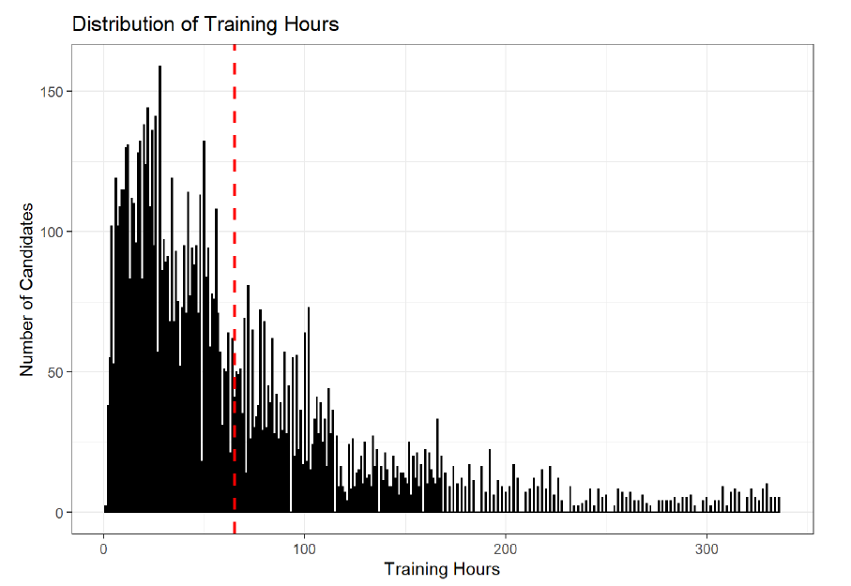
Exploratory Data Analysis - Training Hours
The red line represents the mean number of training hours (approximately around 70 hours)

Slide 10
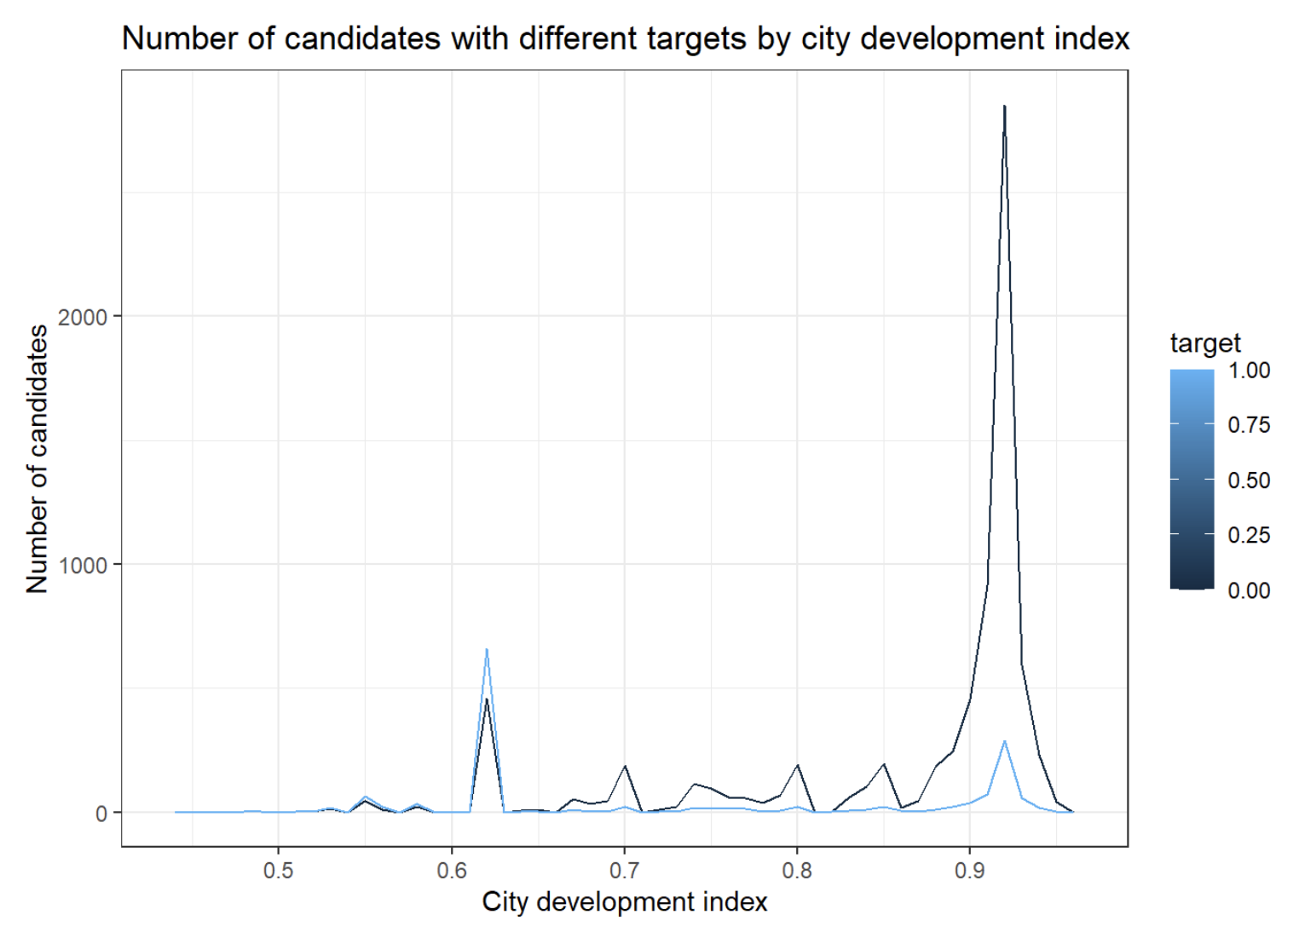
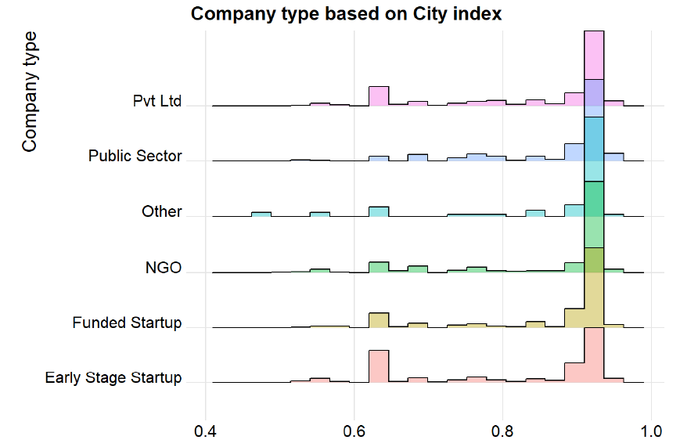
Exploratory Data Analysis - City Development Index
0: Do not accept job offer
1: Accept the job offer

Slide 11
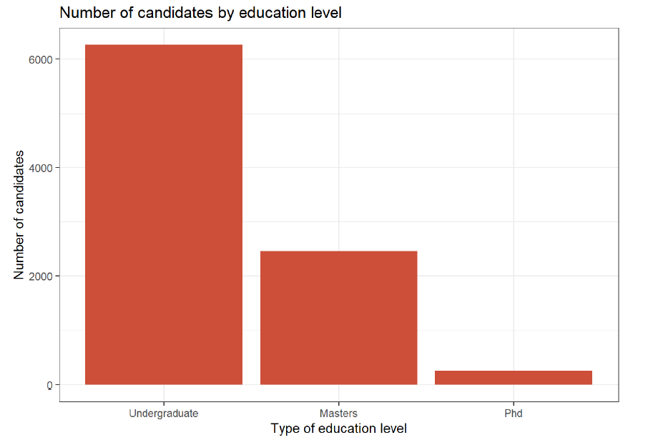
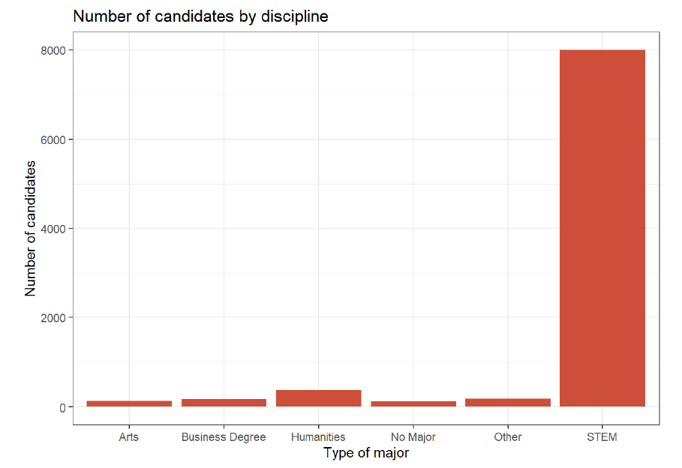
Exploratory Data Analysis - Education, Discipline and University Enrollments

Slide 12
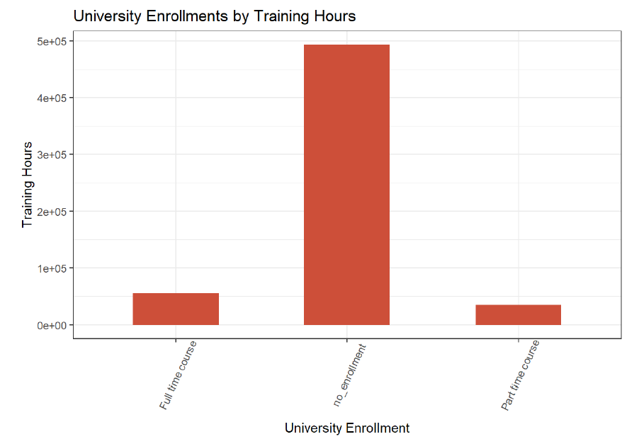
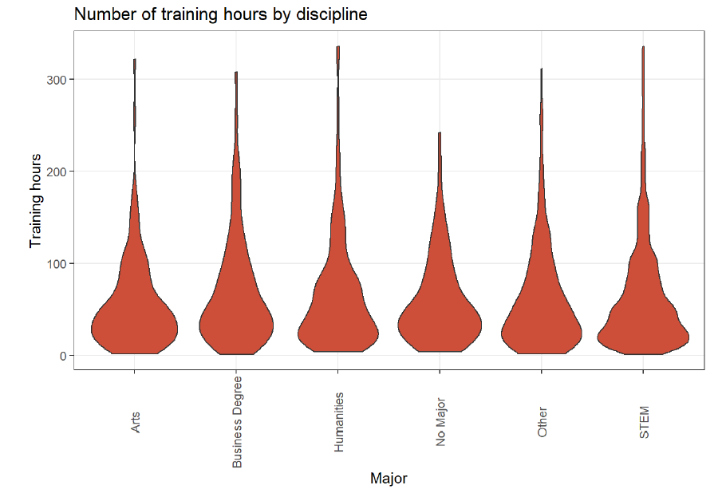
Exploratory Data Analysis - Education, Discipline and University Enrollments
Notes:
Candidates who are not pursuing any courses in the university right now are undergoing training for a longer period of time.

Slide 13
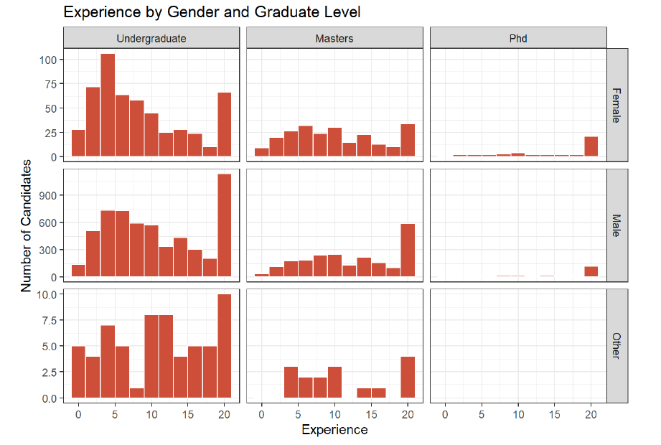
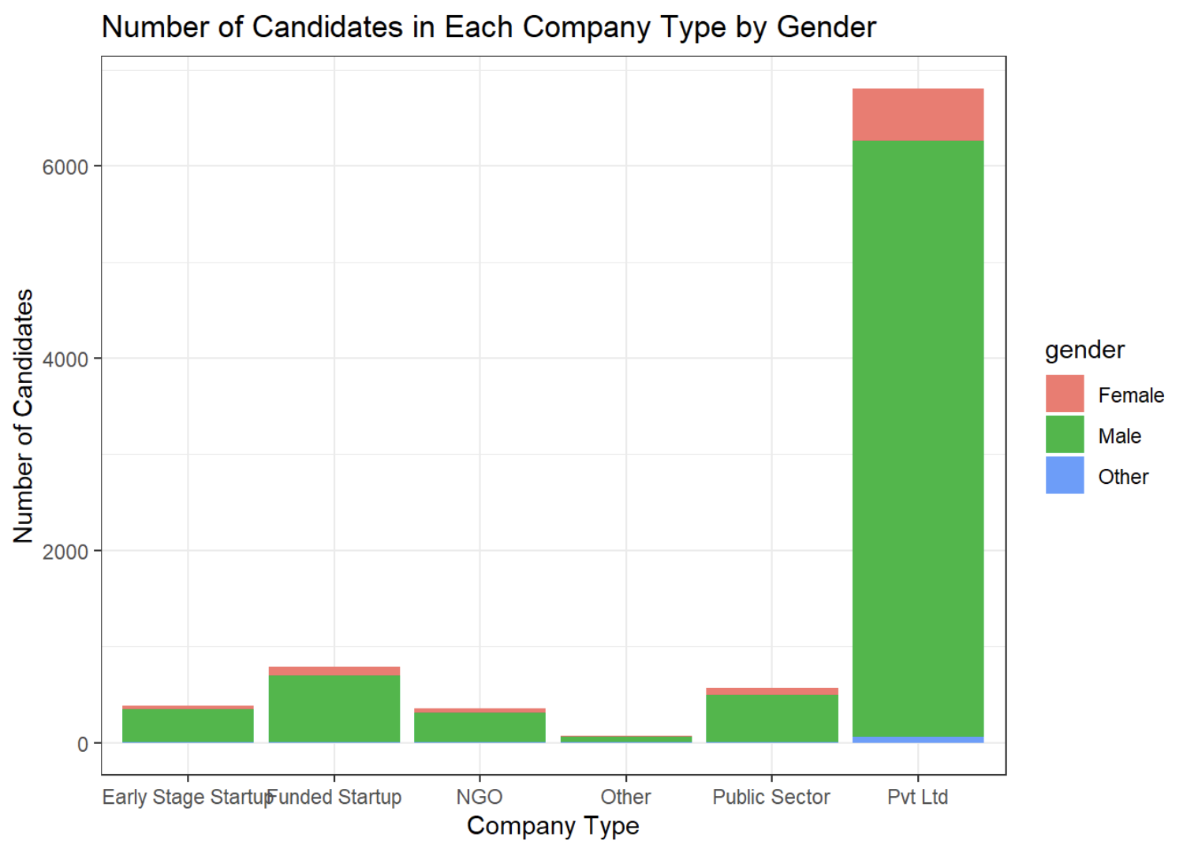
Exploratory Data Analysis - Education, Discipline and University Enrollments

Slide 14
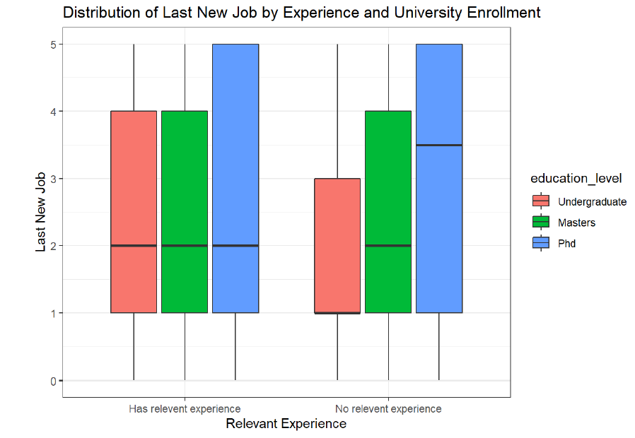
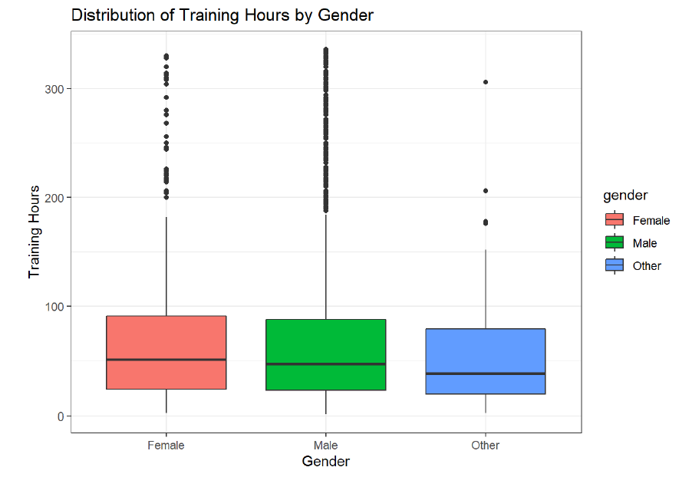
Exploratory Data Analysis - Education, Discipline and University Enrollments

Slide 15
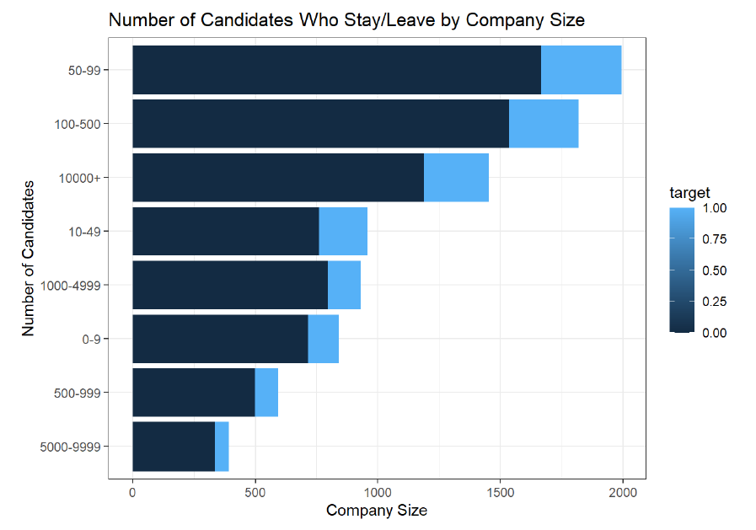
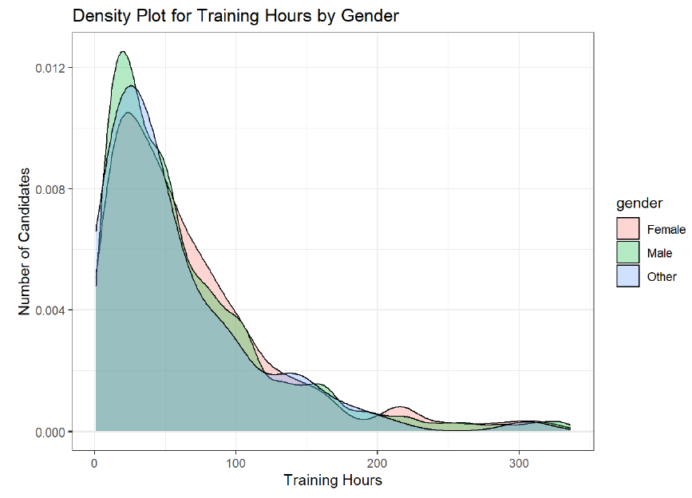
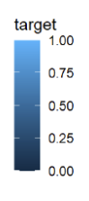
Exploratory Data Analysis - Work Experience, Company Type and Gender
0: Candidates that rejected job offer
1: Candidates that accepted job offer

Slide 16
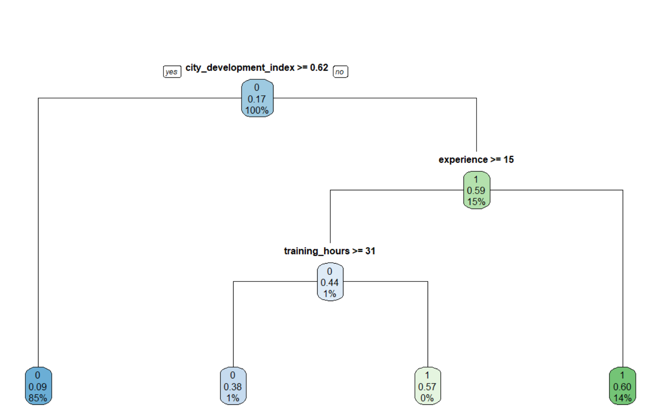
Classification Models to Predict if Candidates Will Accept/Reject Job Offer
Simple Representation of Trees
Notes:
We started by trying to get a better sense of which variables were most important. For that we fit a simple decision tree using rpart. In this tree, we can see that city development index was used in our first decision split. Candidates who live in a city development index that is higher than 62% are deemed to reject the job offer. The next decision variable is experience, candidates who don’t have more than 15 years of experience will accept the job offer. And the last important variable in this tree is training hours. Candidates who needed to train for less than 31 hours are going to accept the job offer. Now it is very important that I emphasize that this wasn’t a tree that we would actually use to predict a candidate’s job outcome, it is merely to give the audience a better understanding of what our decision trees may look like and what are the first few most important decision criteria.

Slide 17
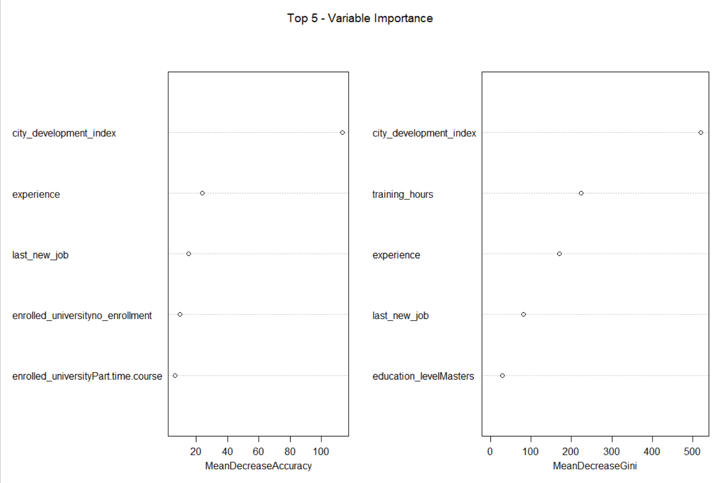
Classification Models to Predict if Candidates Will Accept/Reject Job Offer
Random Forest
Accuracy | 86.18%
Sensitivity (True Positive) | 43.00%
Specificity (True Negative) | 94.37%
Confusion Matrix
 | Actual
Predicted | 0 | 1
0 | 1403 | 136
1 | 106 | 150

Slide 18
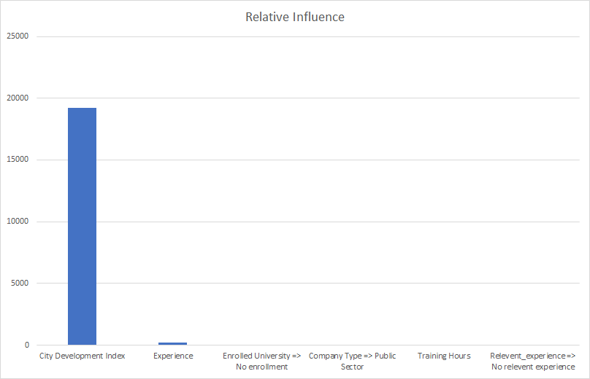
Classification Models to Predict if Candidates Will Accept/Reject Job Offer
Gradient Boost
Accuracy | 86.35%
Sensitivity (True Positive) | 57.45%
Specificity (True Negative) | 91.57%
Confusion Matrix
 | Actual
Predicted | 0 | 1
0 | 1392 | 117
1 | 128 | 158

Slide 19
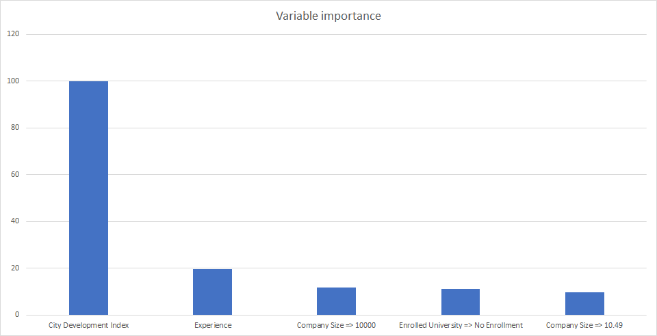
Classification Models to Predict if Candidates Will Accept/Reject Job Offer
Logistic Regression
Accuracy | 84.90%
Sensitivity (True Positive) | 55.03%
Specificity (True Negative) | 87.60%
Confusion Matrix
 | Actual
Predicted | 0 | 1
0 | 1442 | 67
1 | 204 | 82

Slide 20
Regression Models to Predict City Development Index
MSE (train/test)
Linear = 0.01177169 / 0.01170526
Ridge = 0.01177169 / 0.01170527
Lasso = 0.01178403 / 0.01170773
Lambda
Ridge = 0.0001
Lasso = 0.9
Experience is the best predictor for city development index, and candidates with STEM majors, as well as the difference between current and last new job are important predictors of city development index.
*Only using experience / No university enrollment / last new job / STEM discipline (Attributed to the variable importance results).

Slide 21
Chosen Models
Classification
(Test)
Regression
Random Forest
GBM
Logistic
MSE
Accuracy | 86.35%
Sensitivity | 57.45%
Specificity | 91.57%
 | Train | Test
Linear | .01177169 | .01170526
Ridge | .01177169 | .01170527
Lasso | .01178403 | .01170773
Accuracy | 86.18%
Sensitivity | 43.00%
Specificity | 94.37%
Accuracy | 84.90%
Sensitivity | 55.03%
Specificity | 87.60%
Notes:
All models have close accuracy scores, but we selected the Gradient Boost model which has better sensitivity as compared to the rest of the models

Slide 22
Recommendations
Candidates who are more likely to accept the job offer include those who:
Reside in low developed cities
Do not have too much work experience
Do not have any degree from universities (candidates with no formal undergraduate or graduate degrees might be more willing to receive work experience)

Slide 23
Challenges Faced
Low sensitivity rate (57.45%)
Imputation of values while cleaning data
Notes:
Low sensitivity rate (57.45%): Not the best at predicting candidates who are going to be accepting job offers
Imputation of values while cleaning data (examples include changing values with: greater than 20 years of experience as 21, less than 1 year of experience as 0)

Slide 24

Future Work
Research on other variables such as GDP, income and population levels to predict the city development index
Accounting for dimensionality reduction techniques
Notes:
Regression variables used in the model might not be the only variables that are good predictors of the city development index. Unknown variables such as GDP, income and population levels might be better indicators
Checking if dimensionality reduction techniques are required to account for highly correlated variables

